Slide 1

Introduction to the Witchcraft Compiler Collection
Jonathan Brossard @endrazine
22 of October 2016
H2HC Conference, Sao Paulo

Slide 2
TL ; DR
The Witchcraft Compiler Collection is free software (MIT/BSD License). https://github.com/endrazine/wcc
You can write in Lua, Punk-C or C.
No assembly skills required.

Slide 3

Who Am I ?
Who am I ?

Slide 4
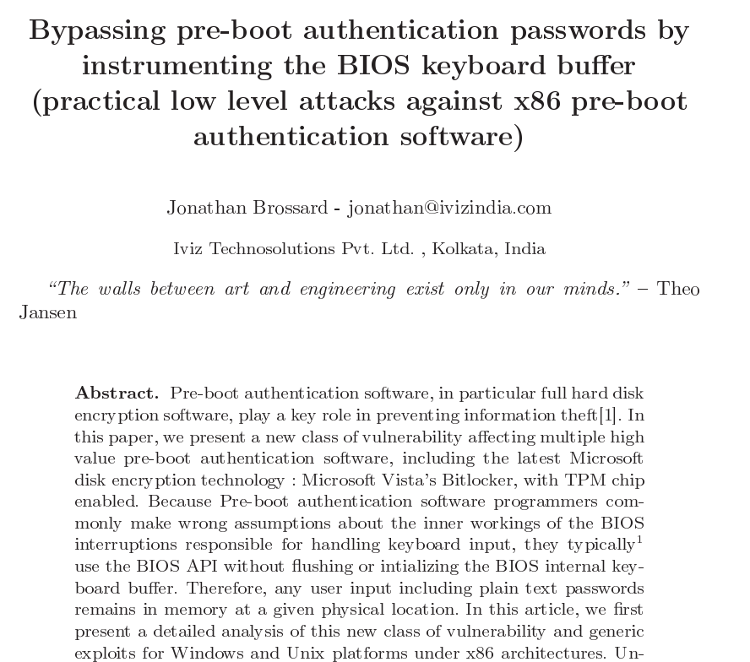

Slide 5
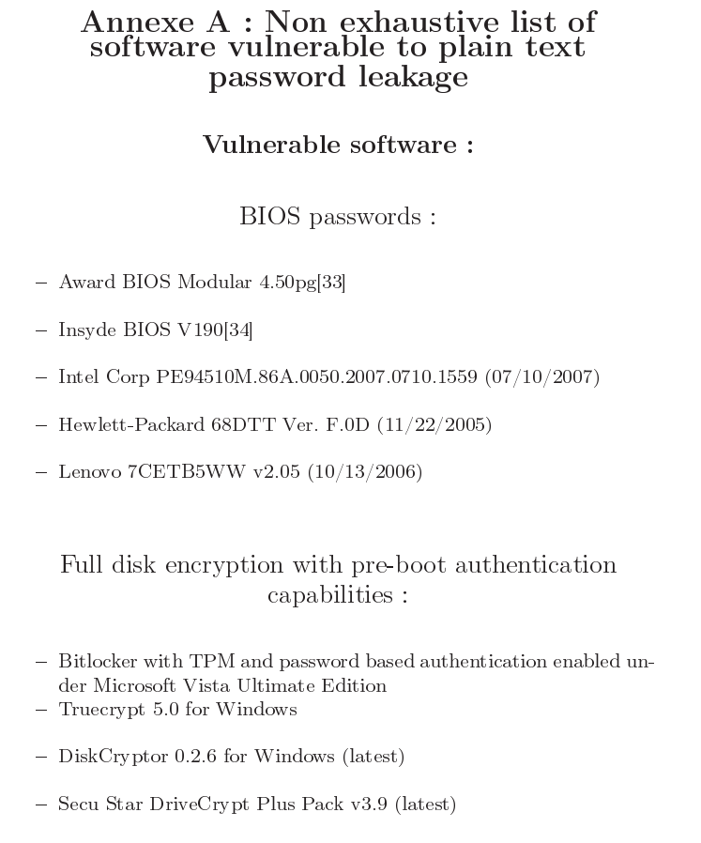

Slide 6
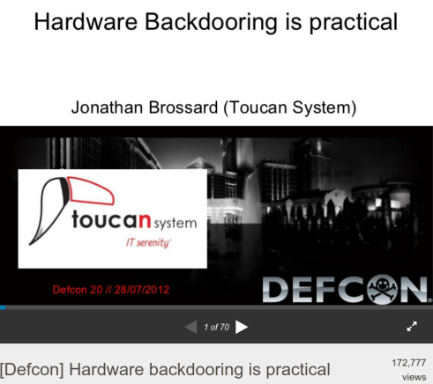
https://www.defcon.org/images/defcon-20/dc-20-presentations/Brossard/DEFCON-20-Brossard-Hardware-Backdooring-is-Practical.pdf

Slide 7
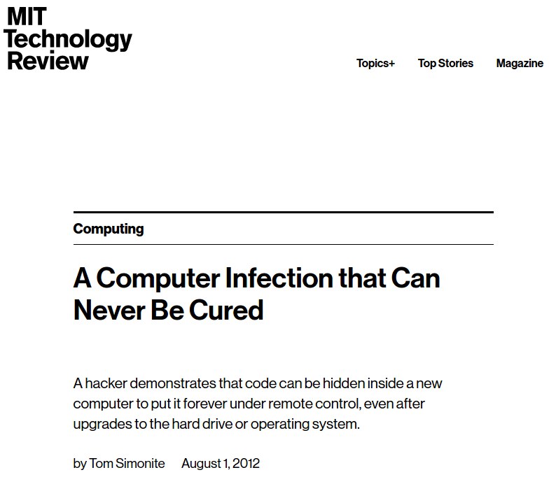

Slide 8
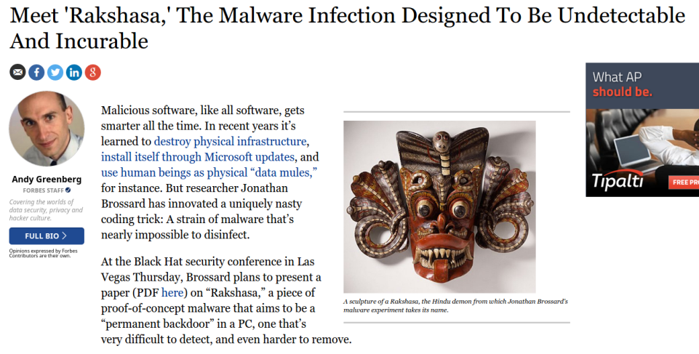

Slide 9
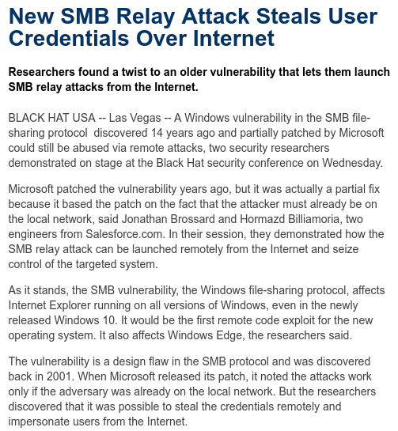
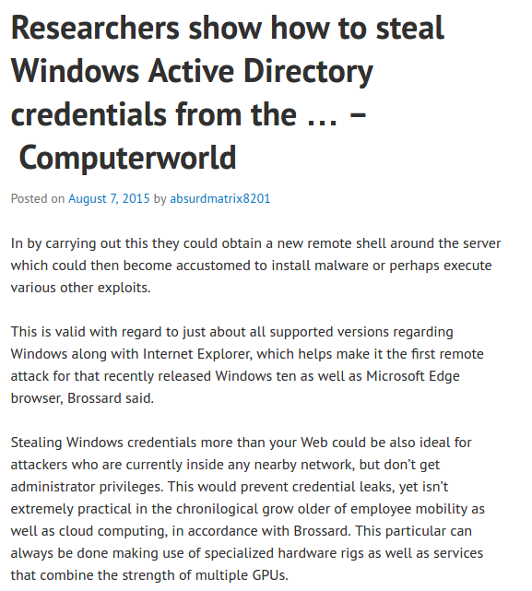
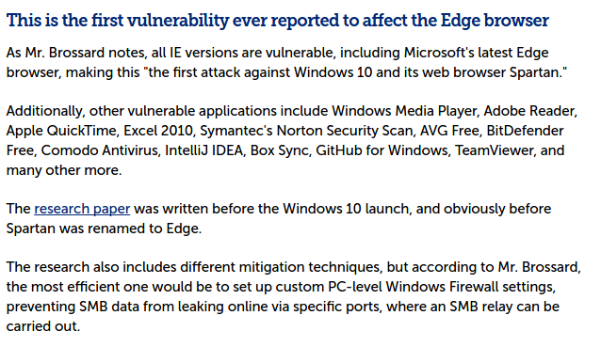

Slide 10
DISCLAIMERS
Disclaimer

Slide 11
DISCLAIMER
My employers are not associated with this talk in any way.
This is my personal research.

Slide 12

Legal help
This talk received help from the EFF.
Warmest thank you to Nate Cardozo, Andrew Crocker and Mitch Stoltz
Free legal advising to security researchers :
https://www.eff.org/ https://www.eff.org/issues/coders/reverse-engineering-faq

Slide 13
Agenda
WCC components
“Libifying” a binary
Unlinking binaries
Crossing a Fish and a Rabbit
Introduction to Witchcraft
Binary “reflection” without a VM
Towards binary self awareness
Future work

Slide 14
WCC : components

Slide 15
WCC Components
Binaries (C):
wld : witchcraft linker wcc : witchcraft core compiler
wsh : witchcraft shell : dynamic interpreter + scripting engine
Scripts (lua, …): wcch : witchcraft header generator wldd : witchcraft compiler flags generator ...
Host machine : GNU/Linux x86_64 (mostly portable to POSIX systems).

Slide 16
Wld : “Libification”
Transforming an ELF executable binary into an ELF shared library.

Slide 17
DEMOS
Libification of proftpd

Slide 18
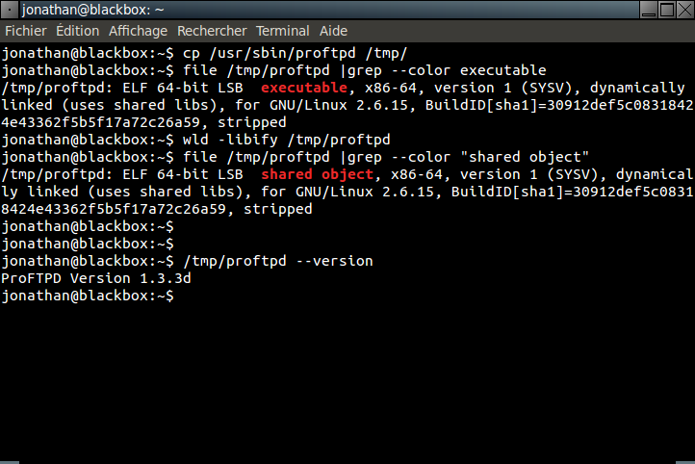
Libification of proftpd

Slide 19
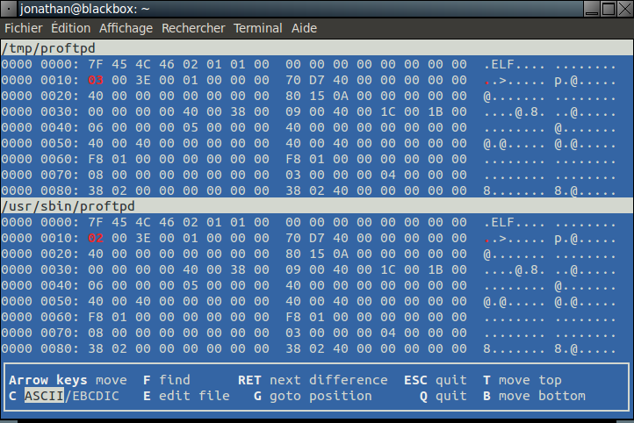
We really patched 1 byte only

Slide 20
libification
typedef struct
{
unsigned char e_ident[EI_NIDENT]; /* Magic number and other info */
Elf64_Half e_type; /* Object file type */
Elf64_Half e_machine; /* Architecture */
Elf64_Word e_version; /* Object file version */
Elf64_Addr e_entry; /* Entry point virtual address */
Elf64_Off e_phoff; /* Program header table file offset */
Elf64_Off e_shoff; /* Section header table file offset */
Elf64_Word e_flags; /* Processor-specific flags */
Elf64_Half e_ehsize; /* ELF header size in bytes */
Elf64_Half e_phentsize; /* Program header table entry size */
Elf64_Half e_phnum; /* Program header table entry count */
Elf64_Half e_shentsize; /* Section header table entry size */
Elf64_Half e_shnum; /* Section header table entry count */
Elf64_Half e_shstrndx; /* Section header string table index */
} Elf64_Ehdr;

Slide 21
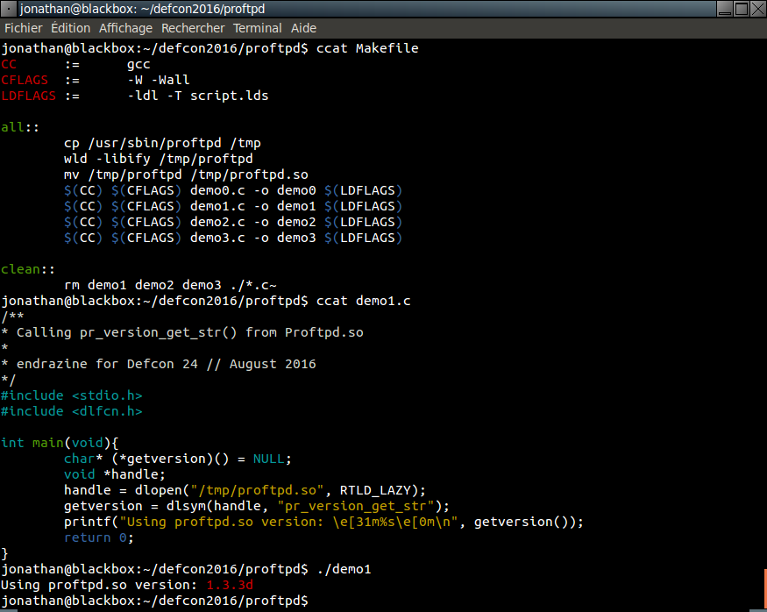
Using our new shared library

Slide 22
How comes this works ?
We’re really creating a “non relocatable” shared library.
ET_DYN and ET_EXEC ELF files are both executable (ASLR support in the kernel)
This is equivalent to creating a shared library with a non NULL base address (equivalent to prelinking)
Note: Amazingly, this shared library is still a valid executable too.

Slide 23
DEMOS
Linking against apache2

Slide 24
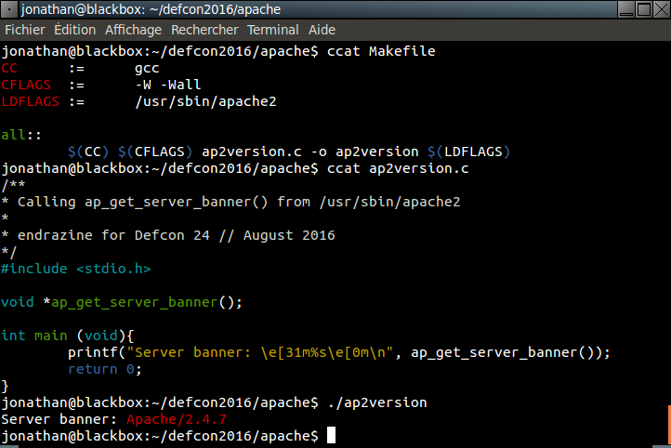
Apache2 as a shared library

Slide 25
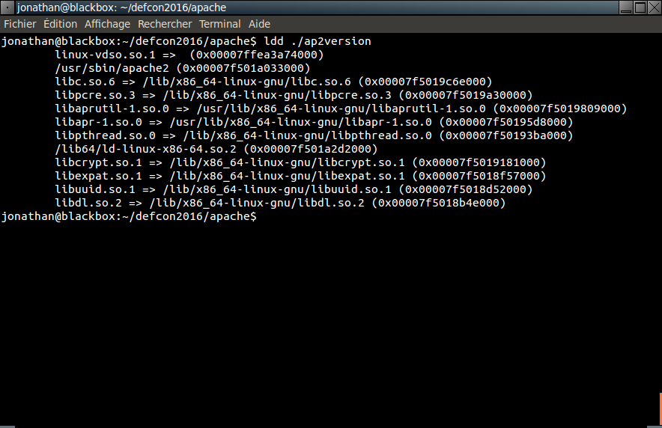
APache2 as a shared library

Slide 26
Wcc : “unlinking”
The typical approach to reverse engineering is to transform binaries or shared libraries back to source code.
Instead, we aim at transforming final binaries or shared libraries back to ELF relocatable objects, that can later be relinked normally (using gcc/ld) into executables or shared objects.

Slide 27
Wcc : “unlinking”
Relocatable objects (*.o)
Source code
Compiler
Li nke r
Binaries (executables, shared libs…)

Slide 28
Wcc : “unlinking”
Source code
Compiler
Relocatable objects (*.o)
Li nke r
Binaries (executables, shared libs…)
Decompiler

Slide 29
Wcc : “unlinking”
Relocatable objects (*.o)
Source code
Compiler
Li nke r
Binaries (executables, shared libs…)
Decompiler

Slide 30
unlinking
Relocatable objects (*.o)
Source code
Compiler
w c c
Li nke r
Binaries (executables, shared libs…)
Decompiler

Slide 31
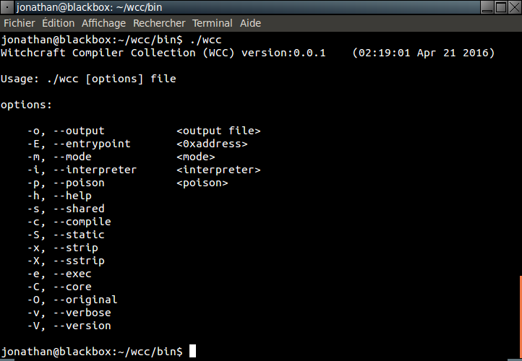
WCC : Command line
The command line is made to resemble the syntax of gcc :

Slide 32
Wcc : internals
The front end is build around libbfd. The backend is trivial C to copy each mapped section of the binary, handle symbols and relocations.
Benefit of using libbfd : the input binary doesn’t need to be an ELF !
=> We can for instance transform a Win64 executable into ELF 64b relocatable objects…

Slide 33
DEMO
(Binary to object file to relocatable to unstripped library)

Slide 34
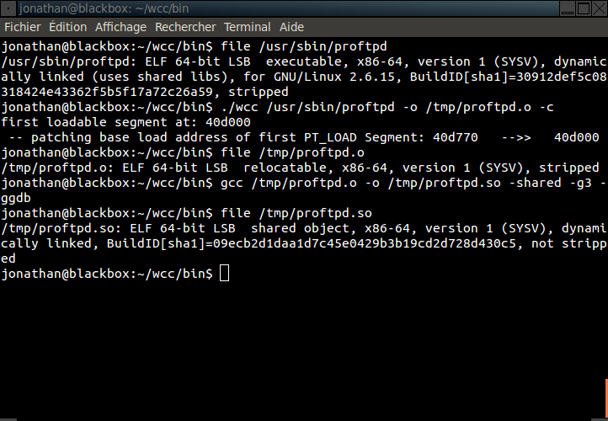
WCC : demo

Slide 35
DEMO
(Crossing a Fish and a Rabbit)

Slide 36



PE + ELF = PELF

Slide 37
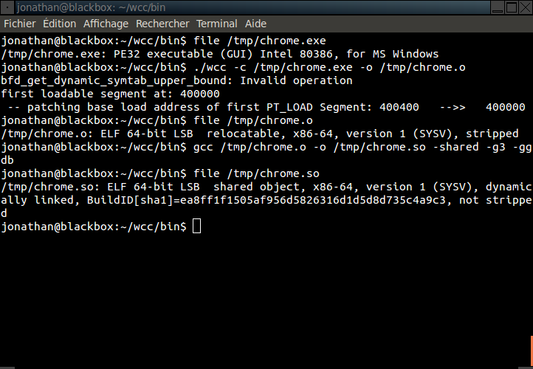
WCC : PE32 to ELF64

Slide 38
DEMO
Native OpenBSD on linux

Slide 39

Introduction to Witchcraft

Slide 40
Binary “reflection” without a VM
Now that we know how to transform arbitrary binaries into shared libraries, we can load them into our address space via dlopen().
Let’s implement the same features as traditional virtual machines, but for raw binaries !
Whish list :
Load arbitrary applications into memory
Execute arbitrary functions with any arguments (and get results)
Monitor/Trace execution
Automated functions prototyping/annotation
Learn new behavior
Examine/Modify arbitrary memory

Slide 41
WSH : architecture
Loading is done via dlopen().
The core engine/shell is built around lua.
Can be compiled with luajit to get JIT compilation.
Tracing/Memory analysis doesn’t rely on ptrace() : we share the address space.
Lightweight : ~5k lines of C.
No disassembler (as of writing. Subject to change).
No need for /proc support !
Function names mapped in each library is dumped from the link_map cache.

Slide 42
Wsh : The wichcraft interpreter
Distinctive features: - We fully share the address space with analyzed applications (no ptrace() nor context switches). - Requires no privileges/capabilities (no root, no ptrace(), no CAP_PTRACE, no /proc…) - No disassembly : fully portable (POSIX)
- Implements “reflection” for binaries - Full featured programming language
- Interactive and/or fully scriptable, autonomous programs
Has no types
Has no fixed API : any function you load in memory becomes available in WSH
Functions have no prototypes
=> Can call arbitrary functions without knowing their prototypes => Allows for extended function annotations (to be fully automated) => Steal/Reuse any code. Add scripting to any application. NONE OF THIS IS SUPPOSED TO WORK

Slide 43
Wsh : The wichcraft interpreter
Advanced features: - Loads any code via dlopen() : this solves relocations, symbols resolution, dependencies for us. - Secondary loader bfd based (could load invalid binaries, anything in memory). - Dumping of dynamic linker cash internals (undocumented) : linkmap
- Breakpoints without int 0x03 (use SIGINVALID + invalid opcode)
- Bruteforcing of mapped memory pages via msync() (0day, no /proc needed) - Wsh can be compiled to do JIT compilation on the fly at runtime.
- Automated fuzzing/extended prototyping/functional testing NONE OF THIS IS SUPPOSED TO WORK

Slide 44
Witchcraft
(Punk-C/Punxie)

Slide 45
Punk-C Language (WSH)
Lua Interpreter + “Reflected” C API = Punk-C

Slide 46
Witchcraft
DEMO

Slide 47
Witchcraft
DEMO ARM

Slide 48
Witchcraft
FUTURE WORK

Slide 49
FUTURE WORK
- Hyde our own presence better in memory (second heap) - Remote debugging, running process injection - Shadow mapping, internal libraries tracing (recursive ltrace) - ltrace/strace to valid scripts - system call tracing

Slide 50
TO BE CONTINUED
Questions ?

